Slide 1
Introduction to Machine Learning Algorithm
JUNCHAO 2017.07.27

Slide 2
WHAT IS MACHINE LEARNING
Machine learning, a branch of artificial intelligence, is about the construction and study of systems that can learn from data.
Applications Areas:
Computer vision : Auto car drive system
Intelligence Search engine
Natural language programming : (http://www.simsimi.com)
Medical diagnosis
Stock market analysis
Biometric : Classify DNA sequences
Strategy game playing : Deep Blue
Robot locomotion
Notes:
Machine learning algorithm involves a large amount of statistical theory and particularly close contact with statistical inference theory, so it can also be known as statistical learning theory.
Machine learning focuses on predict known properties learned from the training data.
Data Mining focuses on the discovery of (previously) unknown properties on the data.

Slide 3
Content
Introduction to the machine learning algorithm in common use
Decision Tree Learning
K-Nearest Neighbor (KNN)
Support Vector Machine (SVM)
Artificial Neutral Networks (ANN)
Naïve Bayes Classifier
Machine Learning in Moderation
Experiment Data

Slide 4
Algorithm types
By learning method
Rote Learning
Learning from instruction
Learning from induction
Learning by deduction
Learning by analogy
Explanation-based learning
By learning process
Supervised Learning
Unsupervised Learning
Semi-supervised learning
Reinforcement learning
Learning to learn
Notes:
Instruction 指令
Induction 归纳
Deduction 演绎
Analogy 类比
Explanation-based 基于理解

Slide 5
Algorithm LIST
Decision Tree LEARNING
K-Nearest Neighbor
Support Vector Machine
Artificial Neutral Networks
Naïve Bayes Classifier
Bayes Network
Expectation Maximization (EM)
Ant colony optimization algorithms (ACO)
…
PageRank
K-Means
Apriori
Ada Boost
Genetic Programming

Slide 6
DECISION TREE LEARNING
Decision tree learning uses a decision tree as a predictive model which maps observations about an item to conclusions about the item's target value.
In these tree structures, leaves represent class labels and branches represent conjunctions of features that lead to those class labels.
Types:
Classification tree
Regression tree

Slide 7
DECISION TREE LEARNING
Notable algorithms of creating tree:
ID3 (Iterative Dichotomiser 3)
C4.5 algorithm : successor of ID3
CART (Classification And Regression Tree)
CHAID(Chi-squared Automatic Interaction Detector)
MARS : extends decision trees to better handle numerical data

Slide 8
DECISION TREE LEARNING
Implementations:
Weka: a free and open-source data mining suite.
Orange: a free data mining software suite.
KNIME: an open source data analytics, reporting and integration platform. (the Konstanz Information Miner)
Advantage:
Simple to understand and interpret.
Requires little data preparation.
Use a white box model.
Able to handle both numerical and categorical data.
Performs well with large data in a short time.

Slide 9
DECISION TREE LEARNING
Limitation:
Learning optimal decision tree problem can be NP-complete.
An over-complex trees that do not generalize the data well.
Ensemble methods:
Bagging decision tree
Boosted Trees
Random Forest
Rotation Forest
Notes:
Ensemble method :

Slide 10
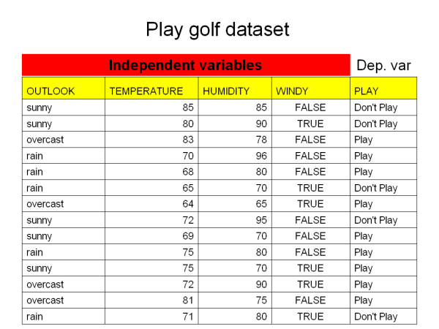
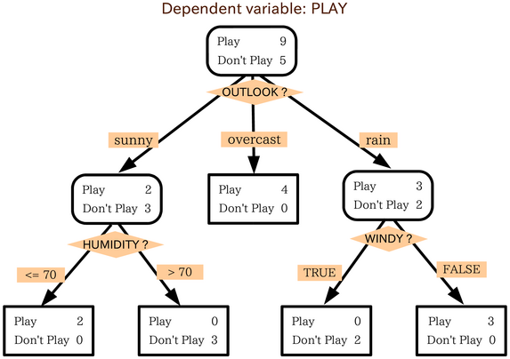
DECISION TREE LEARNING
Sample:
Notes:
树建立起来之后怎样解决问题。
实数量的回归树分析
人立方：读心机器人——猜你正在想的明星是谁？
扩展：贝叶斯网络——马尔科夫链

Slide 11
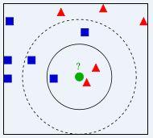
K-Nearest Neighbor ALGORITHM
k-nearest neighbor algorithm is a method for classify objects based on closest training examples in the feature space.
k is a positive integer, can not set for self-adaptation.
Usually Euclidean distance is used as the distance metric.
Overlap metric also can be used.
Application:
Text Classify
Face recognition
Notes:
近朱者赤，近墨者黑。
欧氏距离 Euclidean distance
重叠度量 Overlap metric
海明距离 Hamming distance

Slide 12
K-Nearest Neighbor ALGORITHM
Sample: (k = 1)
Training Data:
buy pharmaceuticals now!
make quick money at the online casino
Nobody owns the water
the quick rabbit jumps fences
the quick brown fox jumps
Test Data:
quick earn money
a quick rabbit

Slide 13
K-Nearest Neighbor ALGORITHM
Advantage:
Algorithm is very simple for using.
Applicable to large amount of sample data condition
Limitation:
Need a lot of computing resource
Base algorithm have special requirement under unbalanced sample data condition
Notes:
优化：八叉树，聚合式
再进一步优化就是聚类思想:K-Means

Slide 14
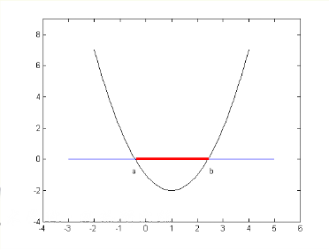
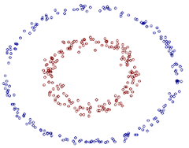


SUPPORT VECTOR MACHINE
Support vector machine are supervised learning models with associated learning algorithms that analyze data and recognize patterns, used for classification and regression analysis.
SVM uses dimension upgrade to solve segmentation problem.

Slide 15
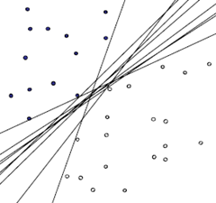
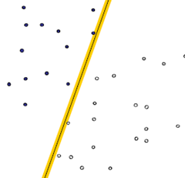
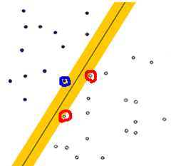
SUPPORT VECTOR MACHINE
Maximum margin hyperplane ： hyperplane whose distance from it to the nearest data point on each side is maximized。
It is known as the maximum-margin hyperplane and the linear classifier it defines is known as a maximum margin classifier.

Slide 16
SUPPORT VECTOR MACHINE
Algorithm Developments:
Fuzzy SVM： Face recognition
Least squares SVM
Weighted SVM
SVM active learning：Text segmentation
Algorithm Improvements:
Vapnik’s chucking algorithm
Osuna’s new algorithm used for face recognition
Joachims use Osuna’s algorithm to solve big problem
Platt’s SMO algorithm (Sequential Minimal Optimization)

Slide 17
SUPPORT VECTOR MACHINE
Implementation:
LIBSVM : a free software from Taiwan (easy to integrate)
SVMLights : a free faster (about 3x) training software.
HeroSVM : a much more faster one (9x-10x) but need money
Feature:
Only support binary classification
Performance rely on number of vectors
Training turns slow when training data is too much
Uses black box models so we can’t see its detail
Notes:
Disadvantage : Black Box

Slide 18
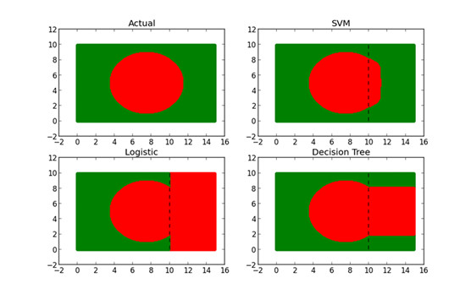
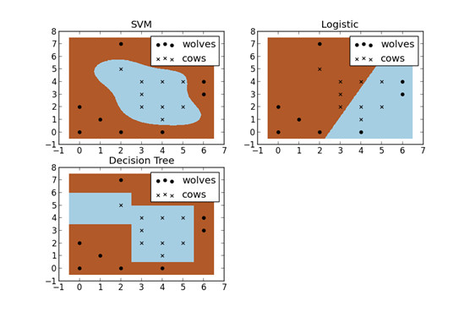
SUPPORT VECTOR MACHINE
Compared with other classify algorithm:
High Accuracy
Non-Linear Classification

Slide 19
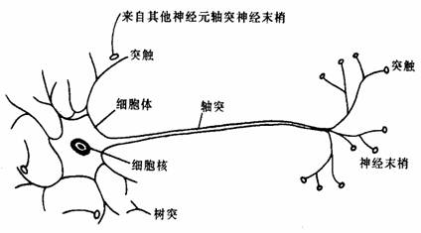
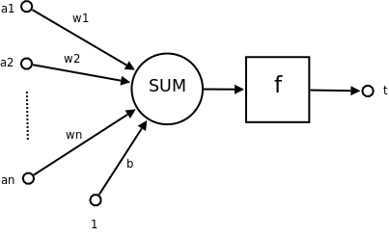
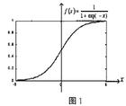

ARITIFICIAL NEUTRAL NETWORKS
Artificial neutral networks is a mathematical model inspired by biological neural networks.
$t=f\left(\overset{→}{W}. \overset{→}{A′}+b\right) , \overset{→}{A}=\left(a1,a2, …an\right)\text{ , }\overset{→}{W}$ = (w₁, w₂, … w_{n})
$t:Output \overset{→}{A} : Input Vector \overset{→}{W} : Weight Vector$
b : Offset f : activation function (non-linear)
Notes:
人脑中神经元数量：1000亿
B阈值 与 W权向量 是需要被训练的目标

Slide 20
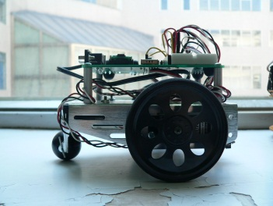
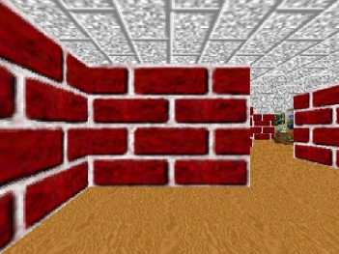
ARITIFICIAL NEUTRAL NETWORKS
w1 w2 w3 w4 t1 t2
L1 L2 L3 L4 Left Right
0 0 0 0 1 0
0 1 1 0 1 1
0 1 0 0 1 1
0 0 1 0 1 1
L1 L2 L3 L4 Left Right
1 0 0 0 0 1
1 1 0 0 0 1
1 0 1 0 0 1
1 1 1 0 0 1
w1 w2 w3 w4 t1 t2
L1 L2 L3 L4 Left Right
1 0 0 1 1 1
1 1 0 1 0 1
1 0 1 1 0 1
1 1 1 1 0 1
L1 L2 L3 L4 Left Right
0 0 0 1 1 0
0 1 0 1 1 0
0 0 1 1 1 0
0 1 1 1 0 1
Notes:
Windows 98 屏保 走迷宫算法

Slide 21
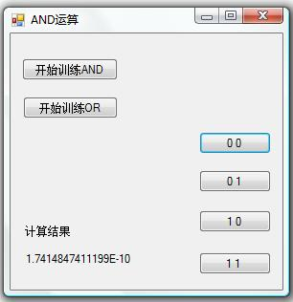
ARITIFICIAL NEUTRAL NETWORKS
TrainSet[] sets = new TrainSet[]{
new TrainSet(0,0,0),
new TrainSet(0,1,0),
new TrainSet(1,0,0),
new TrainSet(1,1,1)
}; NeuralNetwork nn = new NeuralNetwork(2,1); slnn = new SingleLayerNeuralNetworks(nn, sets); slnn.Train(); MessageBox.Show("AND");
this.Text = "AND";
this.button1.Enabled = true; this.button2.Enabled = true; this.button3.Enabled = true; this.button4.Enabled = true;
Notes:
激励函数可以是线性的，也可以是非线性的
常用S型激励函数：f(x)=1/(1+e^{x})

Slide 22
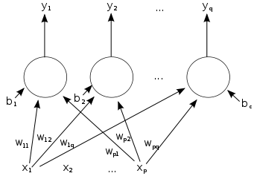
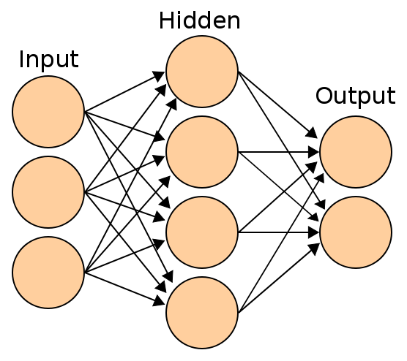
ARITIFICIAL NEUTRAL NETWORKS
Types:
Feedforward Neural Network
Feedback Neural Network
Models:
Single layer ANN
Two Layers ANN
…
Now there are about 40 kind of ANN models
Notes:
Example：Blade Hurt

Slide 23
ARITIFICIAL NEUTRAL NETWORKS
Advantages:
Ability of self learning
Associate and remember function
Custom algorithm have high speed on searching optimal solutions
Incremental Training
Applications:
Pattern Recognition
Signal Processing
Knowledge Engineering
Expert System
Robot Control
Notes:
Disadvantage : Black Box Model

Slide 24

NAÏVE BAYES CLASSIFIER
Naive Bayes Classifier is a simple probabilistic classifier based on applying Bayes’ theorem with strong independence assumptions.
Detail:
$\operatorname{Pr}\left(Category | Item\right)=\frac{\operatorname{Pr}\left(Category\right)}{\operatorname{Pr}\left(Item\right)}{ ∗\operatorname{Pr}\left(Item \right|Category)}$
$\operatorname{Pr}\left(Item | Category\right)=\prod{\operatorname{Pr}\left(Feature \right|Category)}$
$Result=max⁡\{\operatorname{Pr}\left(Item | Category1\right),\operatorname{Pr}\left(Item | Category2\right)…\}$
Notes:
举例分类：黑人的家乡

Slide 25
NAÏVE BAYES CLASSIFIER
Advantage:
Simple but still have a high accuracy.
Training speed is very fast
Performance well at big training data condition.
Limitation:
Have special requirement under unbalanced sample data condition, need training data selection optimize.
Sensitive on noisy data
Notes:
依赖训练集的选择是所有机器学习算法都会遇到的问题。

Slide 26

application in moderation
Concept:
Category → Spam & Non-Spam
Item → Document
Feature → Word
Key Point:
$WeightedProbability\left(feature\right)=\frac{weight∗assumedprob+totals\left(feature\right)∗prob(feature|category)}{weight+totals(feature)}$
$weight=1.0 assumedprob=0.5 (1.0/NumberOfCategories)$

Slide 27

application in moderation
FEATURES ALL SPAM GOOD $b(Spam)$ $b(Good)$ $f(Spam)$ $f(Good)$ $j(Spam)$ $j\left(Good\right)$
buy 1 1 0 50.00% 25.00% 75.00% 25.00% 75.00% 25.00%
now 1 1 0 50.00% 25.00% 75.00% 25.00% 75.00% 25.00%
make 1 1 0 50.00% 25.00% 75.00% 25.00% 75.00% 25.00%
quick 3 1 2 50.00% 62.50% 44.64% 55.36% 37.50% 62.50%
money 1 1 0 50.00% 25.00% 75.00% 25.00% 75.00% 25.00%
rabbit 1 0 1 25.00% 41.67% 25.00% 75.00% 25.00% 75.00%
jumps 2 0 2 16.67% 61.11% 16.67% 83.33% 16.67% 83.33%
……

Slide 28
application in moderation
Man\Com White Black Total Recall
White 5901 371 6272 94.08%
Black 389 1768 2157 81.97%
Total 6290 2139 8429
Precision 93.82% 82.66%
Man\Com White Black Total Recall
White 6123 149 6272 97.62%
Black 415 1742 2157 80.76%
Total 6538 1891 8429
Precision 93.65% 92.12%
Man\Com White Black Total Recall
White 6271 1 6272 99.98%
Black 639 1518 2157 70.38%
Total 6910 1519 8429
Precision 90.75% 99.93%

Slide 29
application in moderation
Man\Com White Black Total Recall
White 7750 460 8210 94.40%
Black 770 71 841 8.44%
Total 8520 531 9051
Precision 90.96% 13.37%
Man\Com White Black Total Recall
White 7799 411 8210 94.99%
Black 767 74 841 8.80%
Total 8566 485 9051
Precision 91.05% 15.26%
Man\Com White Black Total Recall
White 8205 5 8210 99.94%
Black 841 0 841 0.00%
Total 9046 5 9051
Precision 90.70% 0.00%
Notes:
不仅Spam数量很少，Spam彼此之间的词汇重叠也很少

Slide 30


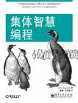
Recommendation
统计学习方法
数据挖掘导论
集体智慧编程
斯坦福大学公开课程：机器学习
加州理工学院公开课：机器学习与数据挖掘
基于神经网络的人机对抗人工智能系统
Notes:
结束语：无论什么技术，能更好的服务于人的技术才是好技术。

